Slide 1


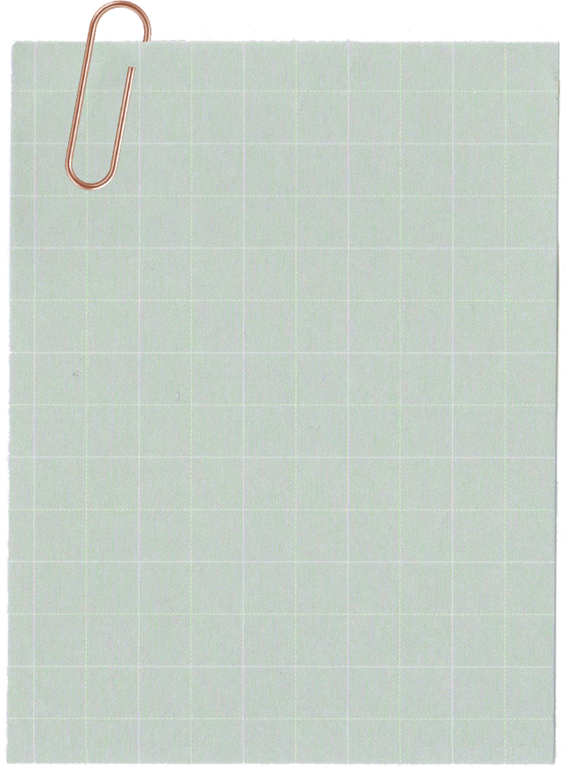
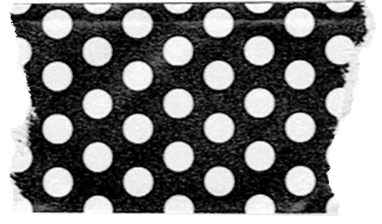
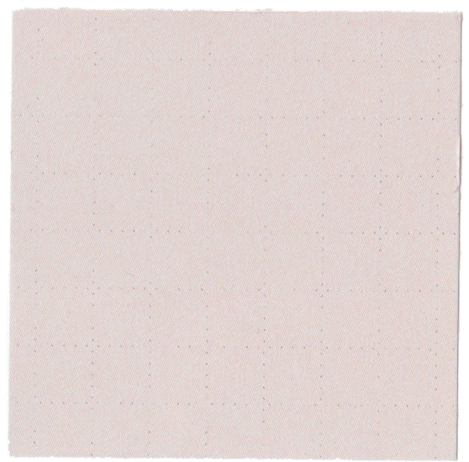
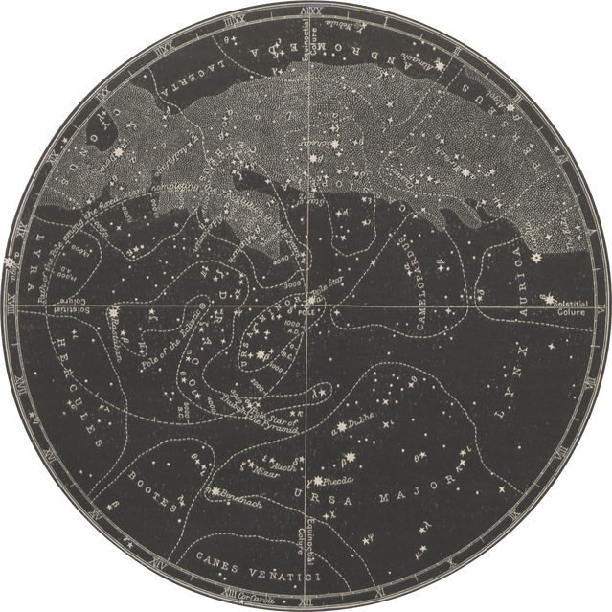





TIC
TAC
TOE
IN PYTHON
Abhishek Dutta

Slide 2
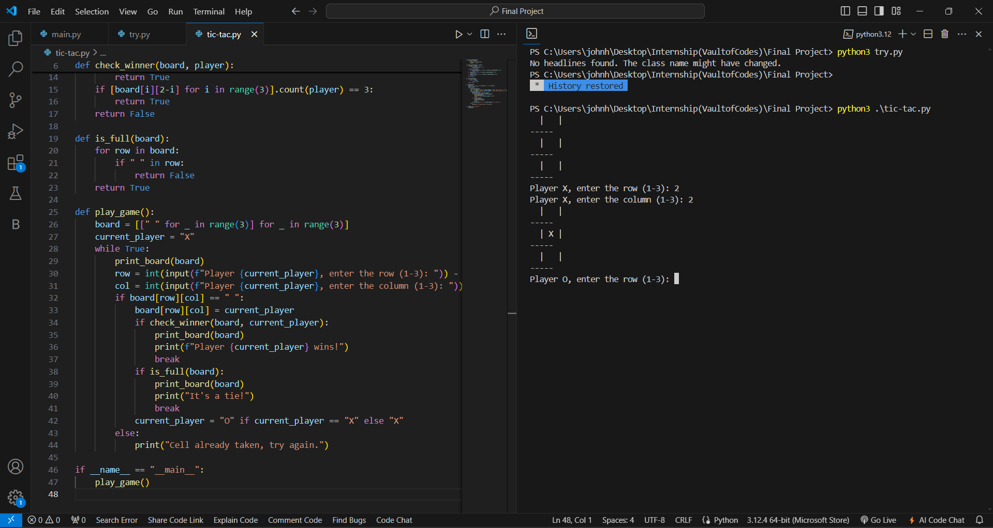
Introduction
In this presentation, I’ll introduce a Tic-Tac-Toe game created using Python. This project includes a simple interface for two players to take turns, a board that updates dynamically, and logic to determine winners or ties. I’ll cover the main components, such as game flow, key functions, and how they work together to deliver a smooth gaming experience.

Slide 3
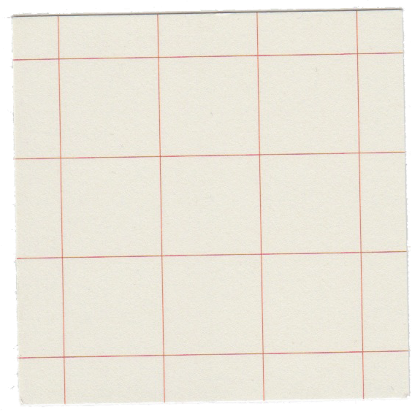


Code Breakdown
in short!
print_board(board) Function
Displays the game board.
check_winner(board, player) Function
Checks if the current player has won the game.
is_full(board) Function
Determines if the board is full, indicating a tie.
play_game() Function
Manages game flow: takes player input, updates the board, and checks for game outcomes.

Slide 4
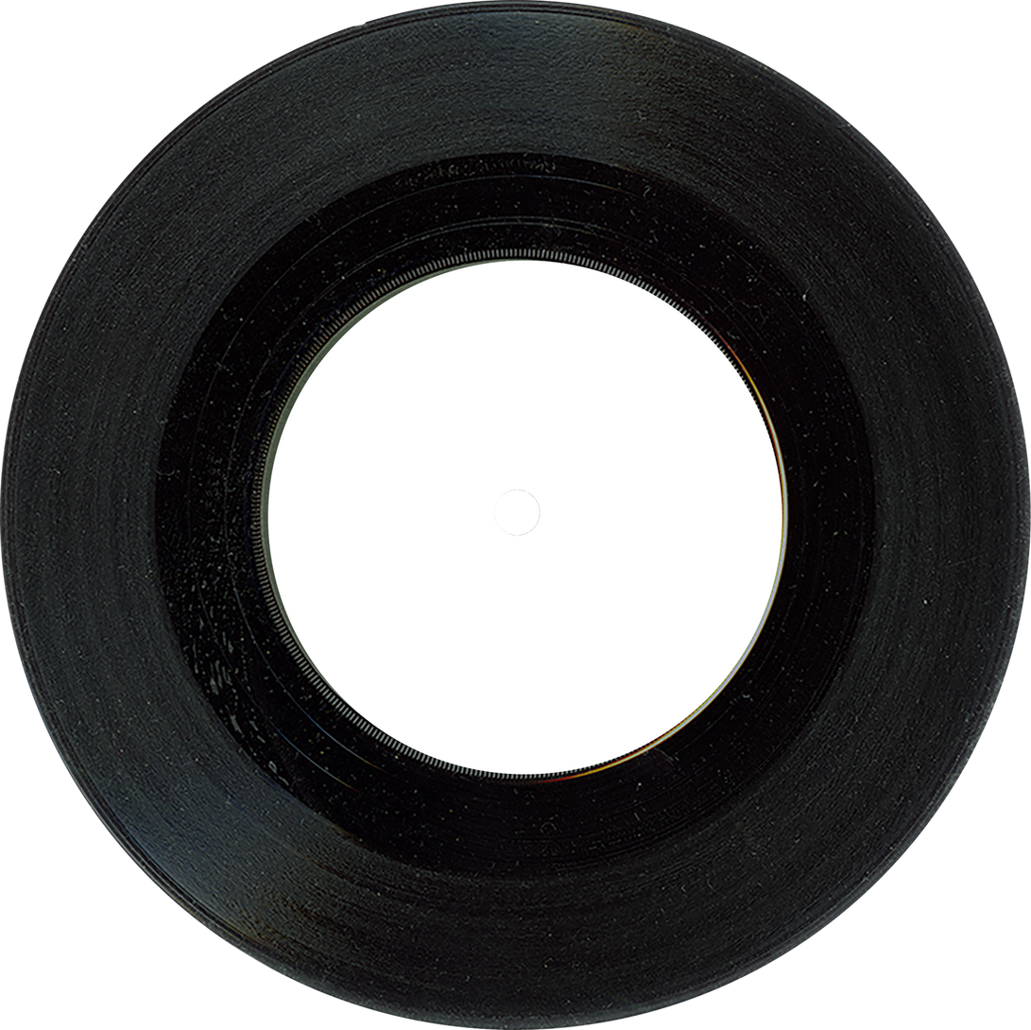
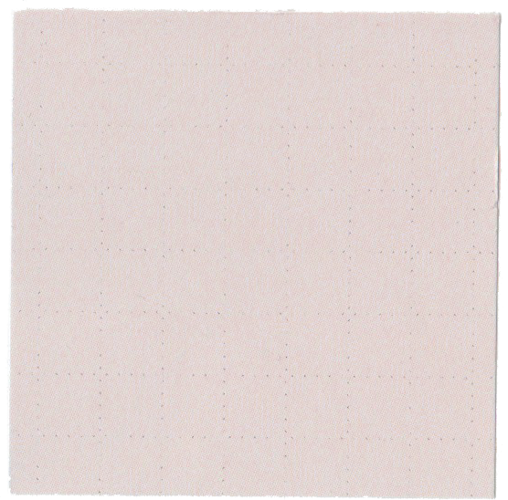
The Game:
1. Game Setup: The game initializes with an empty 3x3 board and starts with player "X".
2. Player Turns: Players take turns entering the row and column where they want to place their mark ("X" or "O").
3. Board Update: After each move, the board is updated, and the game checks if the current player has won or if the board is full.
4. Win/Tie Check: The game checks for a winner by evaluating rows, columns, and diagonals. If no one wins and the board is full, it's declared a tie.
5. Game Continuation or End: If there's no winner and the board isn't full, the game continues with the other player's turn. The game ends when there's a win or a tie.

Slide 5
Advantages
1. Simple and easy to understand.
2. Great for learning basic Python concepts.
3. Organized and modular code.
4. Provides immediate feedback to players.
Disadvantages
1. Limited to console-based interaction.
2. Lacks advanced features like AI or a GUI.
3. No built-in replay option.
4. Prone to human input errors.
Advantages and Disadvantages

Slide 6

Future Scopes
1.AI Opponent
2.A GUI
3.Multiplayer Mode
4.Mobile App Developemt

Slide 7
Thank you!

